Slide 1
Design of Image/Video Compression System
EE596 – Image and Video Coding
Mini Project
Dasanayake D.M.M.T.
E/15/056

Slide 2
Introduction
This is a mini project to implement a simplified hybrid video codec with coding tools like Discrete Cosine Transformation, Quantization, and Entropy Coding.
The impact of each coding tool on the codec’s performance will also be investigated here.

Slide 3
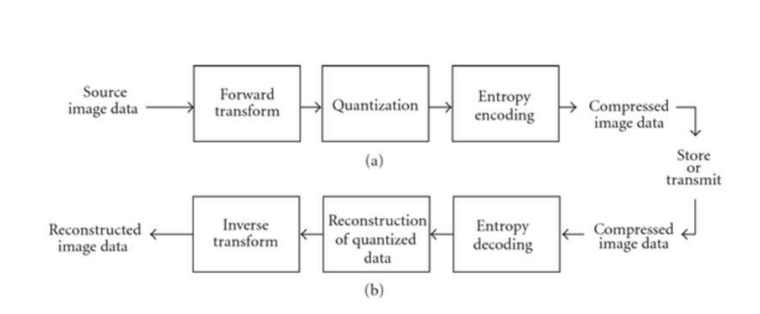
Image Compression System

Slide 4
Image Compression System
Encode an image
Forward Transform
Original Image is converted into Grey Scale and divided into blocks of 8 X 8 pixels. Discrete Cosine Transform is applied.
Quantization
Quantization can be done in different levels.
Quantization matrix is used with a desired Quality Factor.
Entropy encoding
Huffman Coding is used.
Decode an image
Inverse steps of above are used.

Slide 5


Image Compression System
Image which have to be compressed
Compressed image

Slide 6
Video Compression System
Encode a video
Original video is broken into desired number of frames and converted frames into Gray Scale.
First frame is selected as the I frame and Image Compression System is used to encode and decode it.
Motion compensation is performed to obtain predicted frames and motion vectors.
Residual of P frames are calculated and entropy encoded.
The obtained motion vectors and entropy coded residual of P frames are transmitted.

Slide 7
Video Compression System
Decode a video
Frames are reconstructed using received encoded data.
Output video is created using the reconstructed frames.

Slide 8

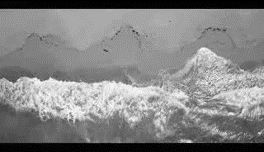
Video Compression System
Video which have to be compressed
Compressed video

Slide 9
Thank you

